Slide 1


Out-of-School Settings E-Learning and Call for Evidence Stakeholder Comms Pack

Slide 2
Call for Evidence Comms

Slide 3

Call for Evidence Promotion
OFFICIAL SENSITIVE
Promotion objectives
Spread awareness and encourage participation – actively promote the Call for Evidence within your networks
Link to CfE Out-of-School Settings Safeguarding: Call for evidence
Expand reach across the sector – encourage a diverse range of stakeholders to contribute their thoughts and opinionsto use the resource, helping to ensure a wide range of voices are considered in any future reforms
How you can help
Complete the CfE to inform us about your knowledge of safeguarding in OOSS and your opinions on potential policy approaches
Share the CfE within your networks – via social media, newsletters and email bulletins to reach smaller/harder to reach providers, parents/carers and children/young people
Sector Specific Lines, Facts and Figures.
Sports Organisations: According to a recent survey, 1 in 10 adults are involved in out-of-school settings, with a quarter of these working or volunteering with sports groups - your experience of balancing safeguarding with participation is crucial. Please ensure your views are heard as part of the Department for Education’s Out-of-school settings Safeguarding Call for Evidence: Out-of-School Settings Safeguarding: Call for evidence
For Youth Groups: According to a recent survey, 1 in 10 adults are involved in out-of-school settings, with just under a quarter (23%) of these working or volunteering with youth groups – help the Government understand what works in your community, by completing the Department for Education’s Out-of-school settings Safeguarding Call for Evidence: Out-of-School Settings Safeguarding: Call for evidence
For Faith Communities: According to a recent survey, 1 in 10 adults are involved in out-of-school settings, with 12% working or volunteering with faith communities " - ensure your voice is heard in shaping inclusive safeguarding approaches, by completing the Department for Education’s Out-of-school settings Safeguarding Call for Evidence: Out-of-School Settings Safeguarding: Call for evidence
For Creative/Arts Organisations: [Creative/Art/Dance/Music (delete as appropriate)] settings support thousands of children - share how you maintain safe, inspiring environments, by completing the Department for Education’s Out-of-school settings Safeguarding Call for Evidence: Out-of-School Settings Safeguarding: Call for evidence
For Supplementary Education: : From private tuition to language schools to cultural education - help the Government understand your unique safeguarding considerations, by completing the Department for Education’s Out-of-school settings Safeguarding Call for Evidence: Out-of-School Settings Safeguarding: Call for evidence

Slide 4
Call for Evidence Promotion
OFFICIAL SENSITIVE
Parental Engagement Lines, including facts and figures:
For parents: Out-of-school activities – like sports, music, tutoring, youth groups, and faith-based learning – play a big role in children and young people’s lives, with 80% of children aged 10-15 engaging in at least one extra-curricular activity in out-of-school settings.
Help make sure these settings stay safe, supportive, and fun places for everyone, by sharing your thoughts and experiences in the Government’s Out-of-school settings Safeguarding Call for Evidence: Out-of-School Settings Safeguarding: Call for evidence
Additional lines that can be shared:
The Out-of-School Settings safeguarding Call for Evidence is open to any interested individual or organisation, and aims to understand:
  approaches, challenges, and gaps in safeguarding practice
  views on potential long-term reforms to improve safeguarding awareness and practices in OOSS
  DfE have worked closely with key safeguarding partners, sector representatives, and parents on the development of proposals for further enhancing safety of these settings.
The Call for Evidence opened on 29 May 2025 and is due to close on 21 August 2025

Slide 5

Out-of-School Settings (OOSS) Call for Evidence Content & Context
OFFICIAL SENSITIVE
Call for Evidence content
Questions on information on the current practices, safeguarding incidents, understanding and awareness of safeguarding in OOSS
Questions on understanding of safety and security in OOSS
Questions exploring new options via 3 policy approaches:
  Registration/regulation (mandatory/voluntary, national/local, regulation/unregulated)
  Engagement with the sector i.e. accreditation schemes and partnerships
  Better information to inform parents, providers and potentially children on safeguarding best-practice
Call for Evidence Context
The Call for Evidence intends to inform the development of safeguarding policy in OOSS and will help us gather data on:​
  current practices, understanding and awareness of safeguarding in OOSS, from providers, parents and safeguarding experts​
  Preferences on initial policy approaches to OOSS safeguarding reform, and some of the tentative options within those approaches
Who it is for
Parents and carers
DfE stakeholders
OOSS providers (supplementary schools, tuition centres, sports clubs, faith groups etc)
Safeguarding organisations (e.g NSPCC, Ofsted)
Accreditation bodies (e.g. Tutor’s Association, Accreditation UK)
Local authorities
Bodies with safeguarding responsibilities e.g. Police, Children’s Commissioner
Individuals doing paid or unpaid work in any of the above organisations
Schools, colleges and young people

Slide 6
Out-of-School Settings (OOSS) and E-Learning Context
OFFICIAL SENSITIVE
OOSS Context
Most children attend some form of OOSS – for example, sports clubs, youth clubs, private tuition, religious groups e.g. Sunday schools or madrassahs, and uniformed youth organisations.
We recognise that many OOSS do a great job providing enriching activities and education to children, across many subjects, including arts, language, music, sport and religion. However, we want to ensure this is the case for all OOSS
All OOSS providers have a legal duty of care to ensure the safety of children that attend their setting and protect them from harm.
E-Learning Context
Having a set of consistent safeguarding standards that all settings can follow is an important way of helping to ensure children are kept safe in OOSS
That is why we have created a free-to-access e-learning resource to support OOSS and help ensure consistency in safeguarding practices
This resource complements our guidance and makes it accessible for all providers
There’s a total of 90 minutes of learning, broken down into an introduction module, four main learning modules pre and post course confidence checkers and a quiz at the end
E-Learning Content
Interactive modules: engage with the content through user-friendly modules that break down complex safeguarding information
Modules include: health & safety, safeguarding & child protection, suitability of staff and volunteers, governance
Personalised learner journeys i.e. lone providers, providers with staff and volunteers etc
Practical scenarios: Apply the government’s code of practice to realistic situations with practical scenarios and case studies

Slide 7
E-learning Comms

Slide 8
E-Learning Promotion
OFFICIAL SENSITIVE
Promotion objectives
Spread awareness and encourage participation – actively promote the E-Learning resource to ensure more individuals and organisations engage with it
Expand reach across the sector – encourage a diverse range of OOSS providers to use the resource, helping to improve safeguarding knowledge across different types of settings
Fostering a safeguarding culture – promoting the importance of safeguarding in OOSS by embedding it as a priority within training, policies and daily practices
How you can help
Include the E-Learning in your safeguarding training – integrate the e-Learning module into your organisation’s existing safeguarding training to ensure staff and volunteers are equipped with essential safeguarding knowledge
Sharing E-Learning resources – post links to the e-Learning on your social media channels, newsletters. Include screenshots to grab attention and encourage other OOSS in your network to do the same
Promote and share DfE content – help spread awareness by sharing blog posts and social media updates from the Department for Education to help reach as many providers as possible
Departmental promotion:
The department’s promotional materials will run across digital channels including:
  DfE Education Hub Blog (The Education Hub (blog.gov.uk)) – utilised by the sector and the media
  Social Media – awareness raising with our networks/stakeholders and the public
  Email Bulletin to schools – with lines for schools to share with local OOSS
  Departments external affairs weekly digest – awareness raising with external stakeholders

Slide 9
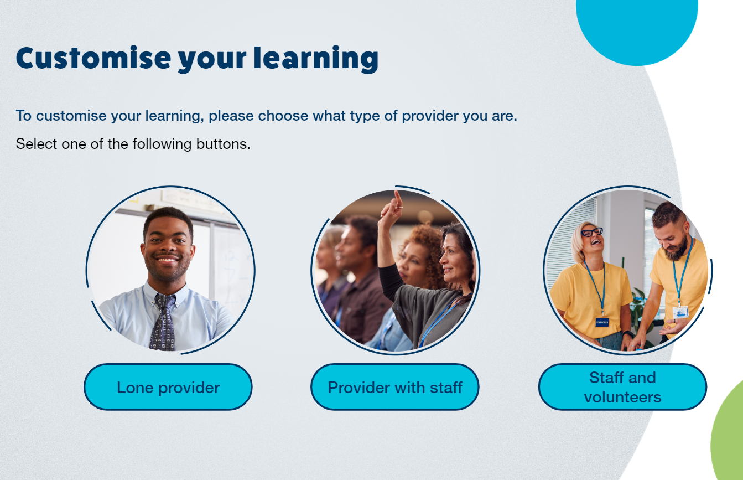

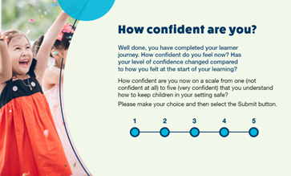

E-Learning resources
OFFICIAL SENSITIVE
Links to share
E-Learning - https://safeguardingooss.vc-enable.co.uk/
Code of practice - Out-of-school settings: safeguarding guidance for providers - GOV.UK
Screenshots of E-Learning to share
Lines to take
The e-learning is a free-to-access package which complements the existing safeguarding guidance for all out of school setting providers by breaking it up into accessible modules
There’s a total of 90 minutes of learning, broken down into an introduction module, four main learning modules pre and post course confidence checkers and a quiz at the end
It’s for any providers, staff and volunteers in OOSS, to provide an introduction to the principles of safeguarding in OOSS

Slide 10
Call for Evidence and E-learning lines

Slide 11
Out-of-School Settings (OOSS) Call for Evidence and E-Learning lines
OFFICIAL SENSITIVE
This Government is committed to safeguarding children and protecting them from harm.
All OOSS providers have a legal duty of care to ensure the safety of children that attend their setting and protect them from harm.
Parents are ultimately responsible for the decision on whether an OOSS is safe for their child to attend, and we have published guidance to help them make an informed choice.
The Government recognises that OOSS offer learning and enriching activities for children, and that these can have significant benefits for children’s mental health and wellbeing, as well as their educational and social development.
We believe that most OOSS provide enriching activities and education across many subjects, including arts, language, music, sport and religion, in a safe environment supported by committed staff and volunteers. We want to ensure this is true for all OOSS – children must be protected, and parents and carers should feel confident that these settings are as safe as possible
That is why we have developed a free-to-access e-learning package, which complements the guidance and makes it accessible for all providers
We have also launched a Call for Evidence to help the Government better understand the sector and shape potential policy proposals. This opened on 29 May and is due to close on 21 August 2025.

